Slide 1

Hindustani Education Society’s
Azad Senior College, Ausa.
(B.Ed Programme)
Accredited With NAAC Grade ‘B’
PROSPECTUS
2025-2026

Slide 2
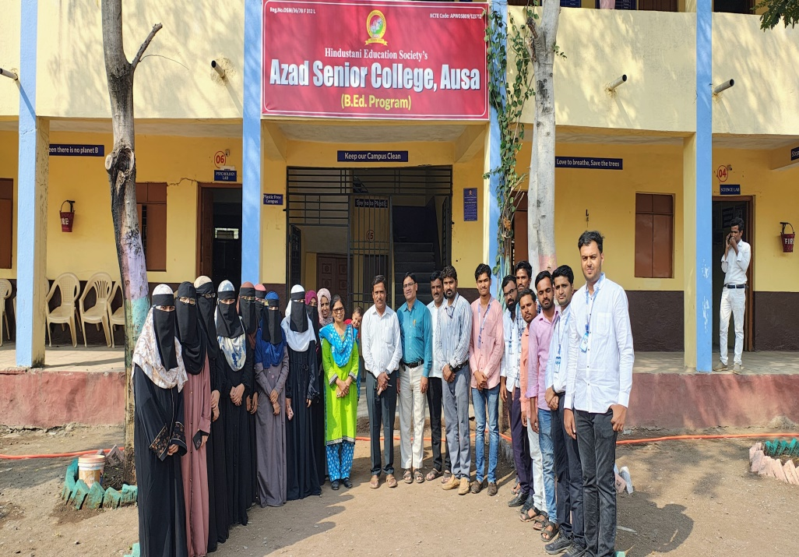
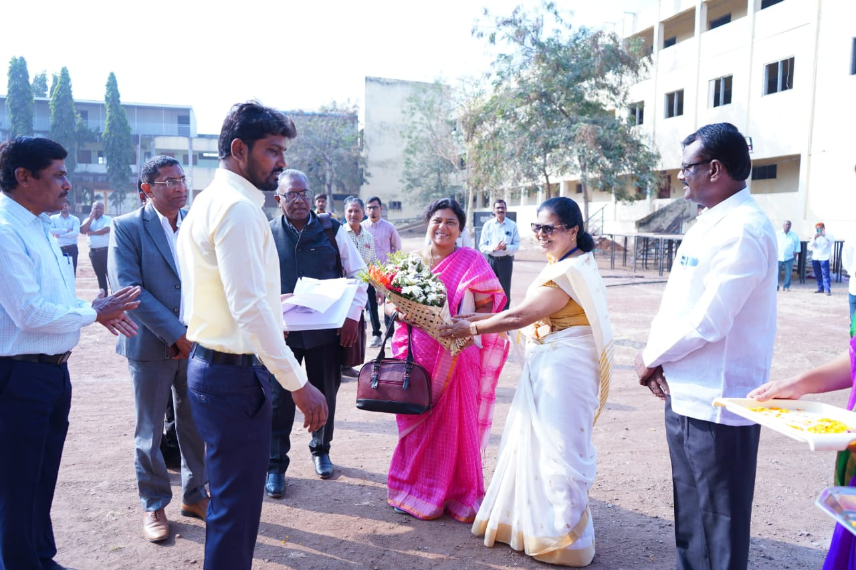
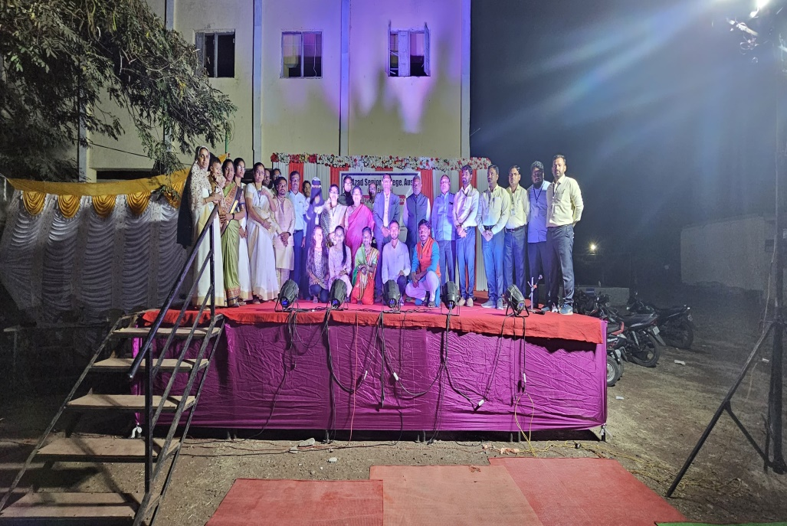
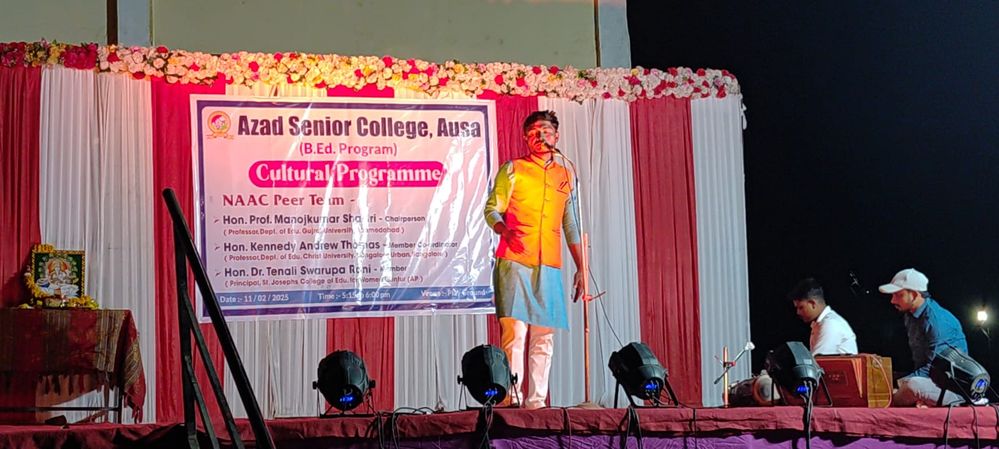

Slide 3
